Slide 1
Customer Churn Analysis

Slide 2


Agenda
A
Introduction
Project Objective
Analysis
Conclusion

Slide 3
Introduction
A Certain bank in North America wants to perform customer churn analysis, as the credit card business of the bank is not performing well . Churn analysis will help bank evaluate the customers who have stopped purchasing the credit card of the bank and figure out measures to reduce the banks customer loss rate.

Slide 4
Project Objective
Analyze Customer who have stopped buying Credit card
Improve Bank Business

Slide 5
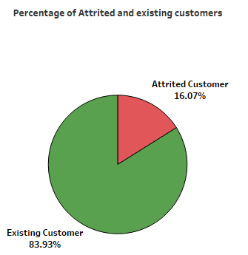
What is the Percentage of Attrited and existing customers?
Conclusion:
Bank has 83.93% of Existing Customer & 16.07% of Attrited Customer

Slide 6
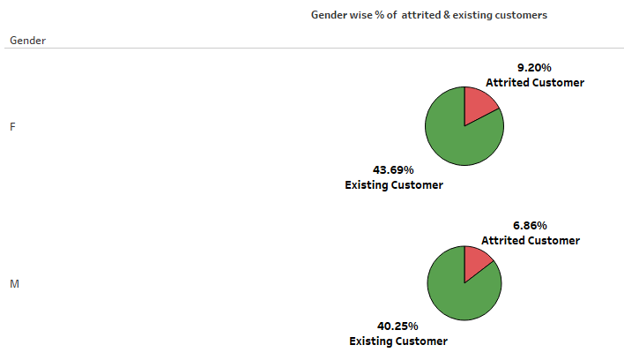
Gender wise percentage of Attrited & Existing Customer
Conclusion:
Females are more attrited Customers
Males are less attrited.

Slide 7
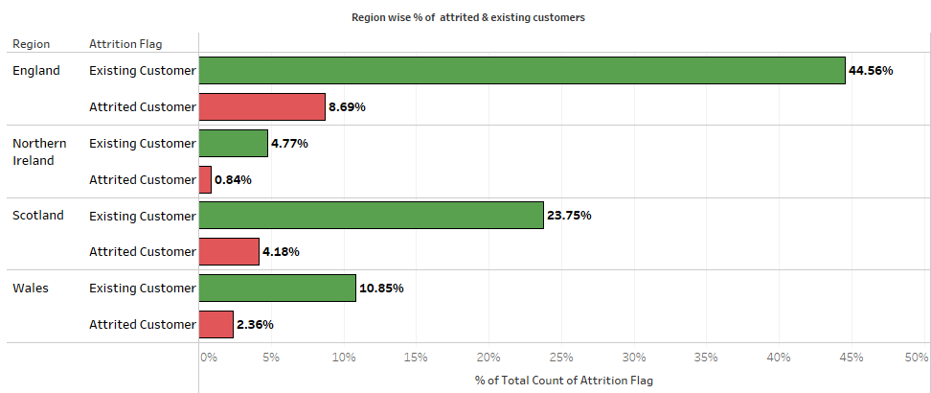
Which Region has more Attrited Customer?
Conclusion:
Percentage of less attrited customers are from Northern Ireland and % of more attrited customers are from England.

Slide 8
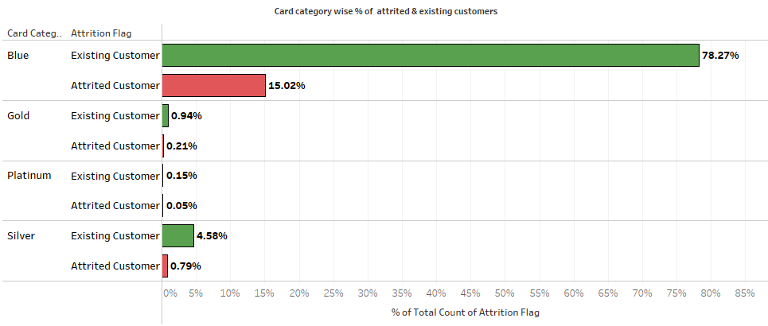
Which Card Category has more Attrited Customer?
Conclusion:
Blue card category has more attrited customers. & Platinum card category has less attrited customers..

Slide 9
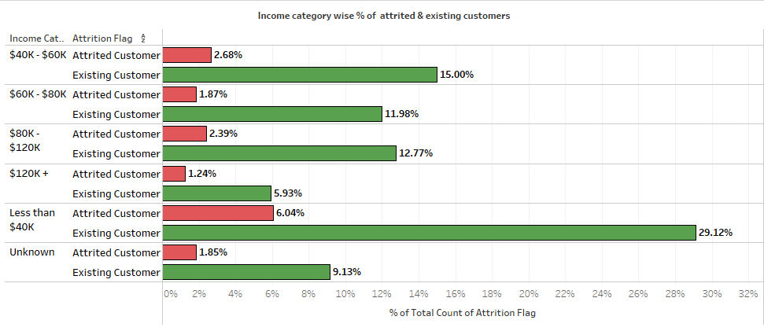
Which Income Group has more Attrited Customer?
Conclusion:
Less than $40K category has more attrited customers.$120K+ Income category has less attrited customers..

Slide 10
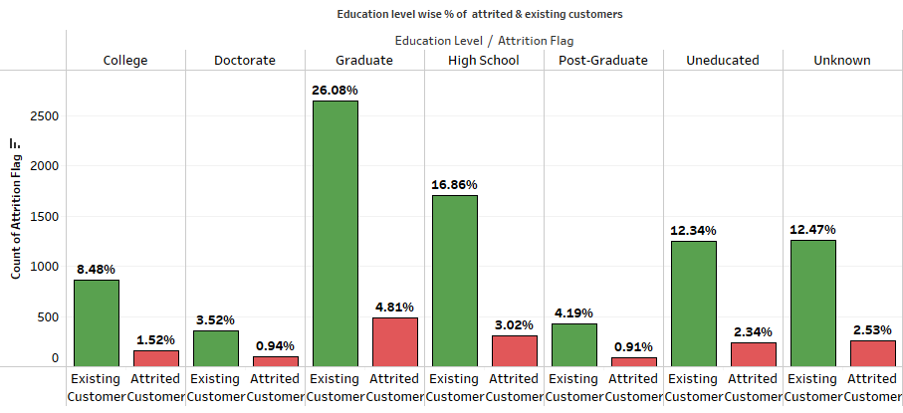
What is Education level of Attrited Customer?
Conclusion:
Most attrited customers are graduates, while less attrited customers are post-graduates.
.

Slide 11
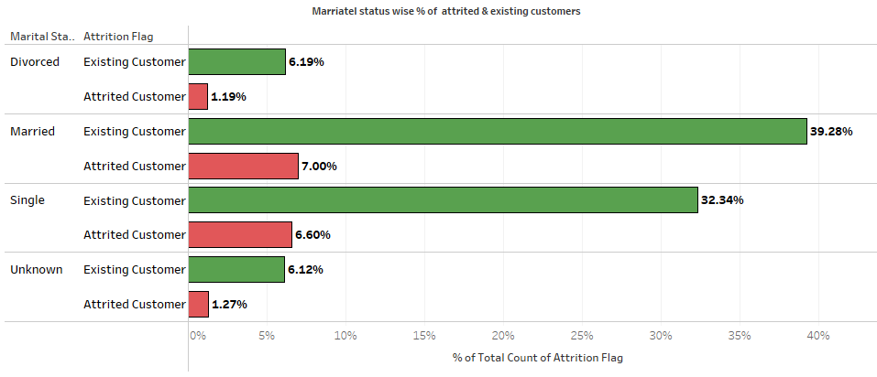
What is Marital Status of Attrited Customer?
Conclusion:
Most of the attrited customers are married .Less attrited customers are Divorced.

Slide 12
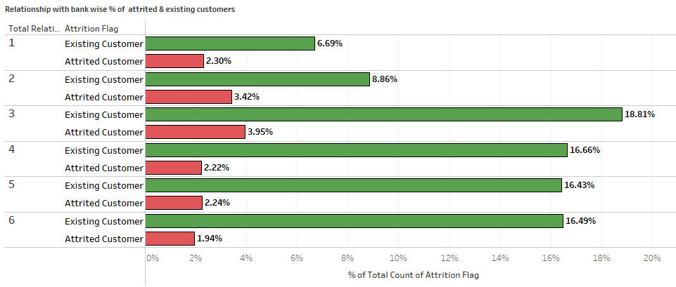
What is Relationship count of Attrited Customer with Bank?
Conclusion:
Total Relationship Count of most Attritied customer is 2 & 3.Total Relationship Count of less Attritied customer is 6.

Slide 13
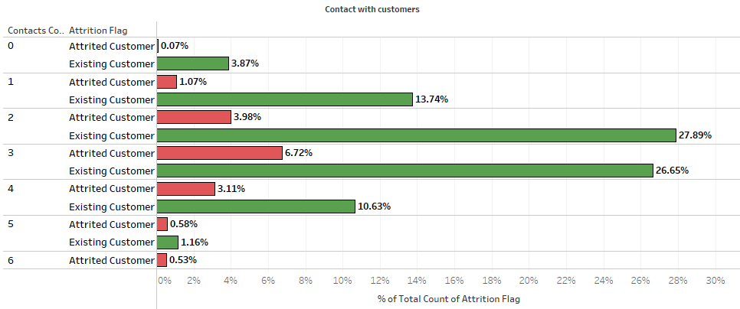
How many times attrited customers contacted in past 12 months?
Conclusion:
Most attrited customers were contacted three times in the past 12 months, while less attrited customers were not contacted at all.

Slide 14
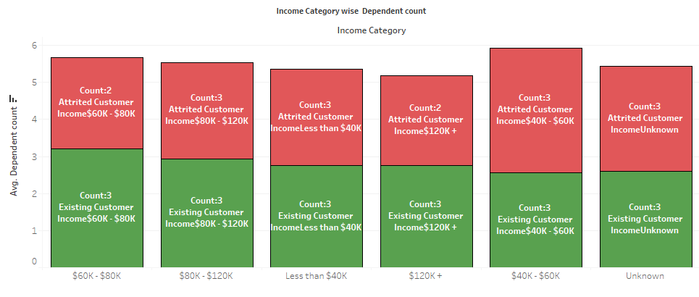
Income Category wise Dependent count
Conclusion:
Most attrited customers have income less than $40K & having 3 dependents. Less attrited customer have income greater than $120K and 2 dependents.

Slide 15
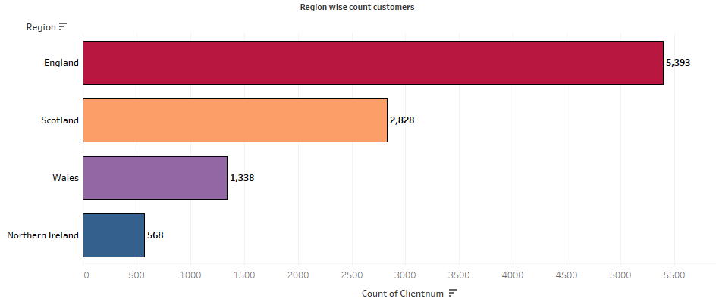
What is count of Customer in each Region?
Conclusion:
Count of customers are more England i.e 5393, followed by Scotland . and less customers in Northern Ireland.

Slide 16
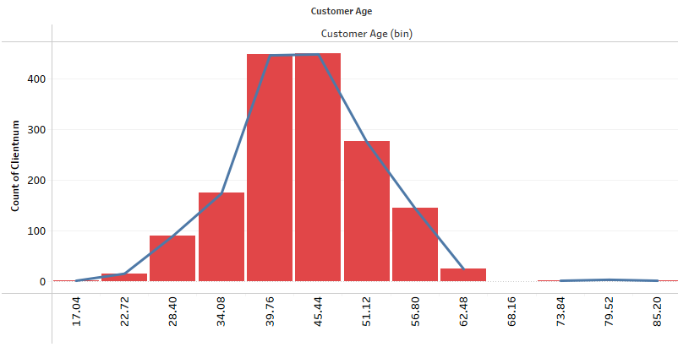
What is Age group of Attrited Customer?
Conclusion:
Most attrited customers are in age group of 39 to 50 years.

Slide 17
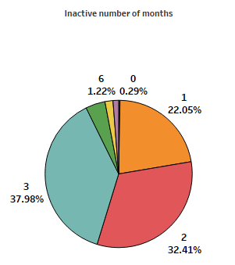
Number of Inactive Months of Attrited Customer
Conclusion:
Attrited customer are inactive for 3,2 months

Slide 18
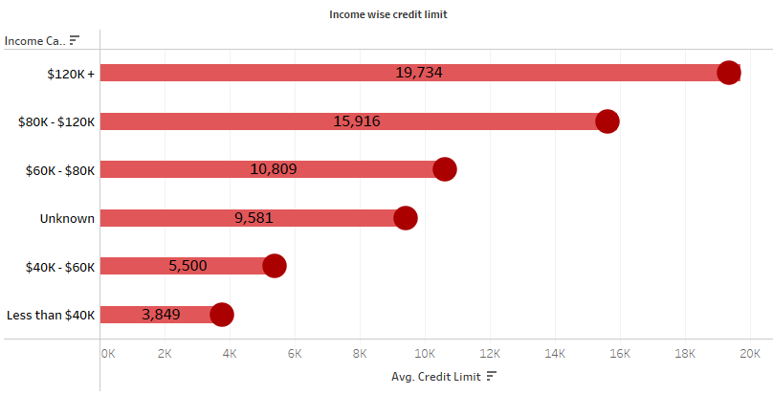
Income wise Credit Limit of Customer
Conclusion:
Customer having more income has more credit limit.

Slide 19
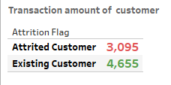
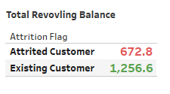
Total Transaction amount & Total Revolving Balance
Conclusion:
Average of Total Revolving Balance of attrited customers is 672.8 & Existing customers is 1256.6
Average Transaction amount of attrited customer is 3095 & Existing Customer is 4655.

Slide 20
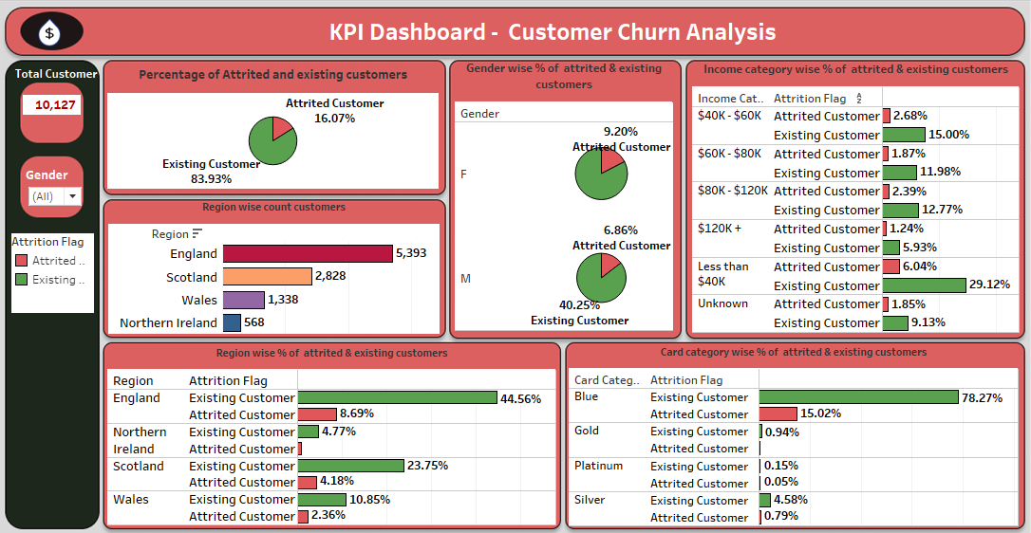
Dashboard

Slide 21
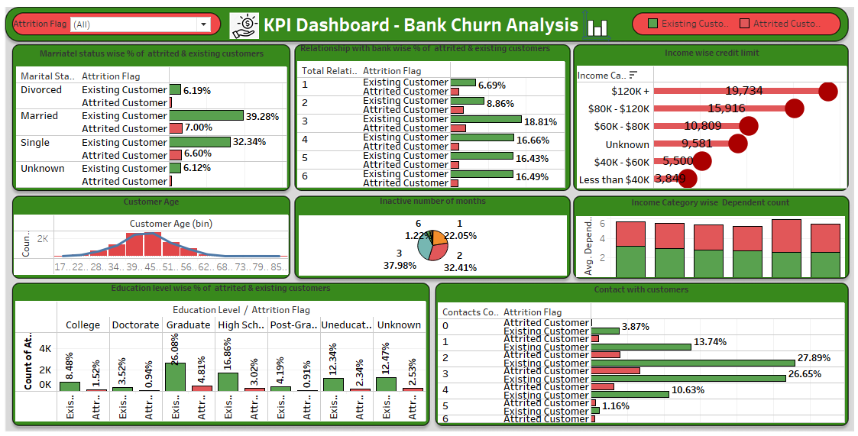
Dashboard

Slide 22
Conclusion
North American Bank has 16.07% of Attrited Customer & 83.93% of Existing Customer.
Married Females Customers are more attrited Customers.
Most attrited customers are graduates, while less attrited customers are post-graduates.
Percentage of less attrited customers are from Northern Ireland and % of more attrited customers are from England.
Blue card category has more attrited customers. & Platinum card category has less attrited customers..
Less than $40K income category has more attrited customers.$120K+ Income category has less attrited customers.
Count of customers are more England i.e 5393, followed by Scotland . and less customers in Northern Ireland.

Slide 23
Conclusion
Most attrited Customers are in age group of 39 to 50 years.
Most attrited customers were contacted three times in the past 12 months, while less attrited customers were not contacted at all.
Attrited customer are inactive for 3,2 months
Customer having more income has more credit limit.
Average of Total Revolving Balance of attrited customers is 672.8 & Existing customers is 1256.6
Average Transaction amount of attrited customer is 3095 & Existing Customer is 4655.

Slide 24
Thank you

